Slide 1
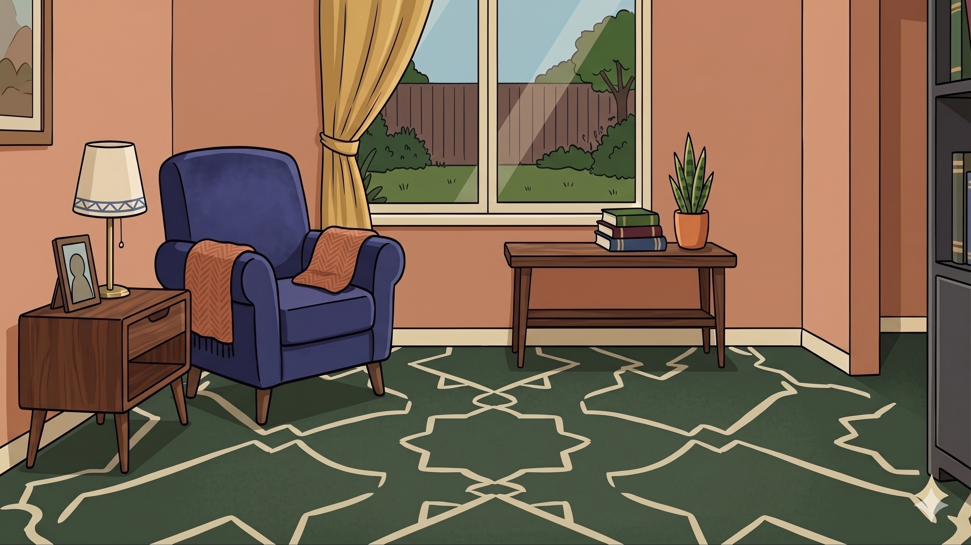
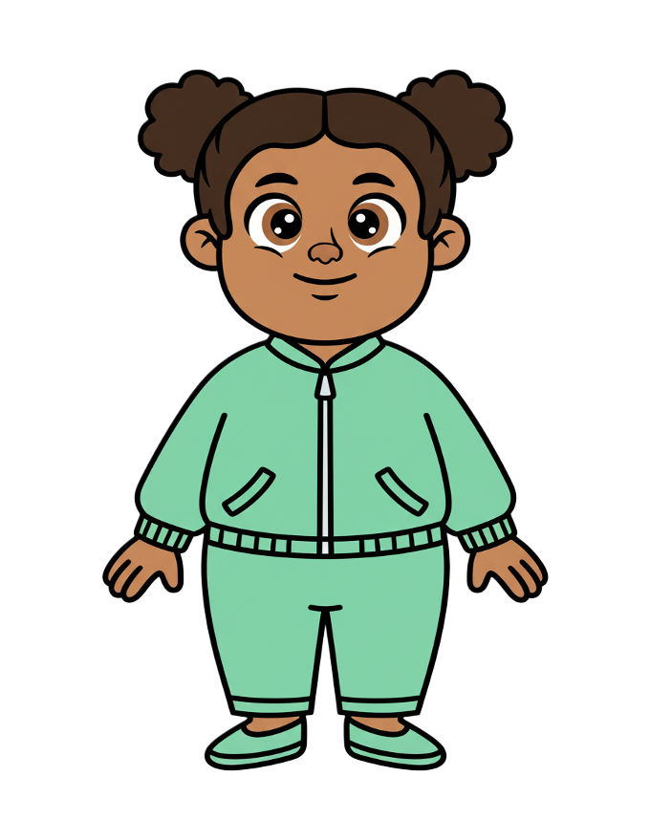
This is Zoe

Slide 2

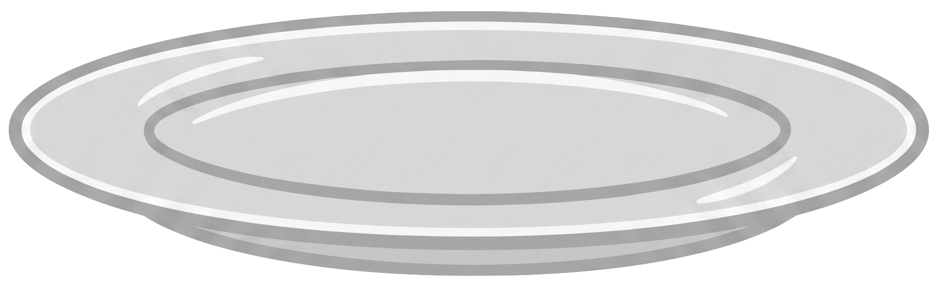
Zoe has 5 cookies

Slide 3
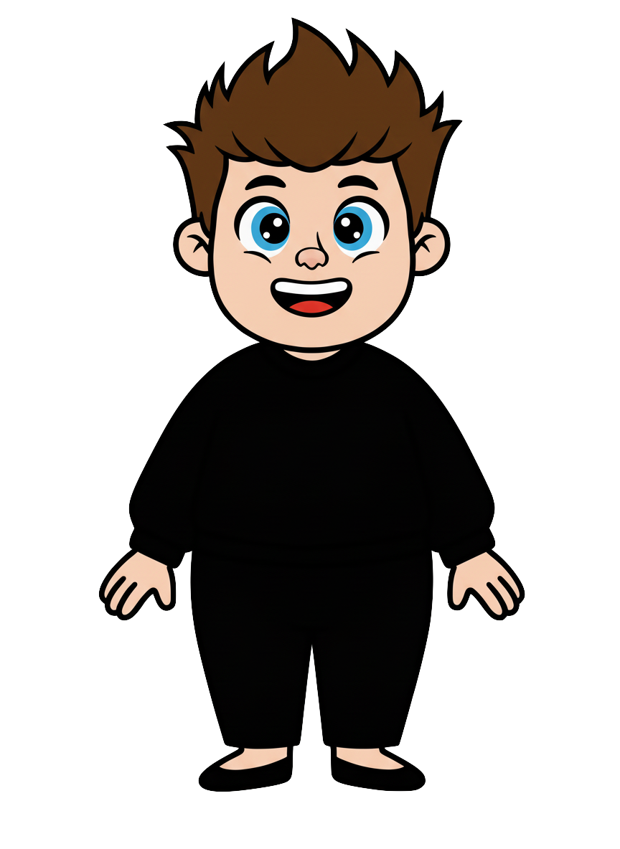
This is Rex

Slide 4
Rex has 3 cookie

Slide 5
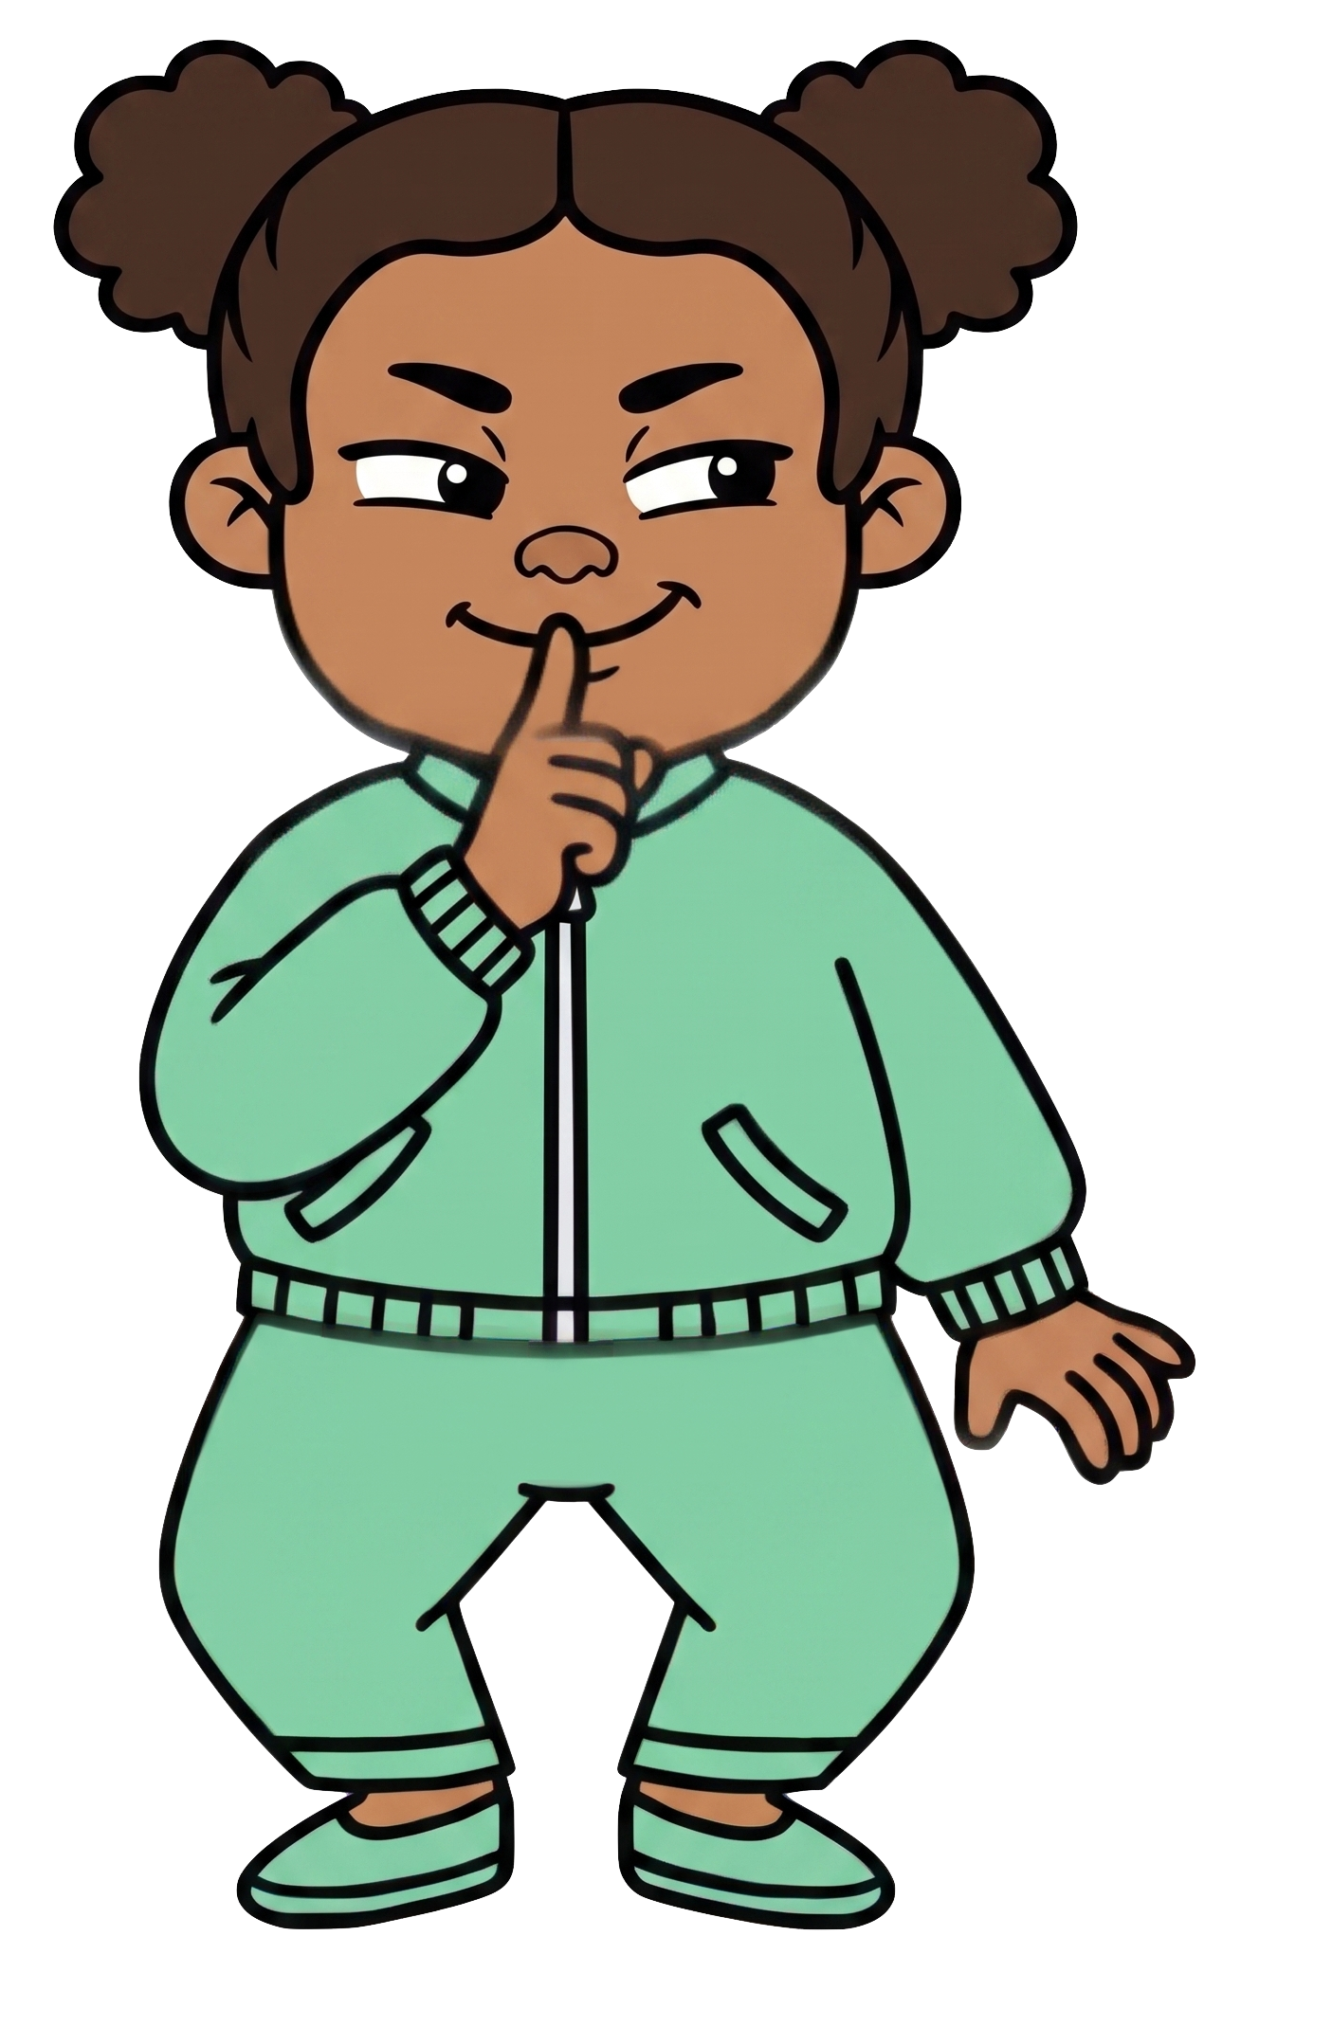
Zoe wants Rex to have fewer cookies

Slide 6
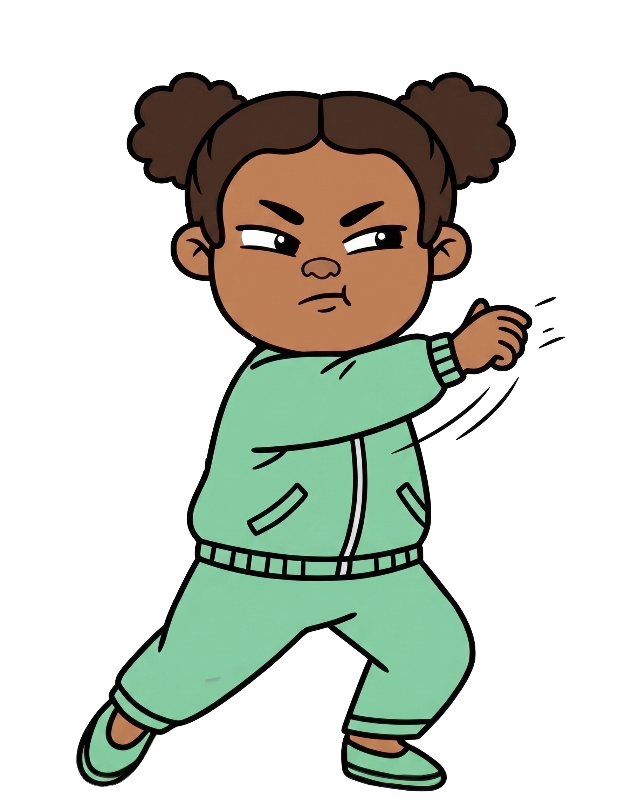

Oh no! Zoe throws 2 of Rex’s cookies!

Slide 7

Zoe still has 5 cookies. Rex now has 1 cookies.

Slide 8
Please decide whether you would like to move some of Zoe’s cookies.

